Slide 1

AllerSafe AI
PREVENT PROTECT RESPOND COORDINATE
Presented by: Team Gravity Coders
Innovators & Engineers

Slide 2

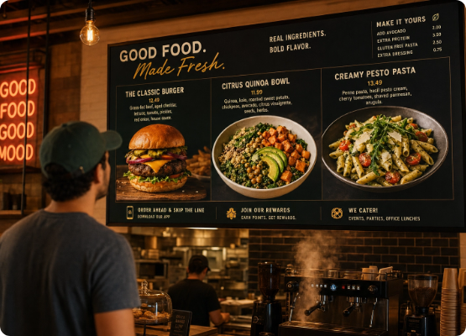
Market Urgency: The Life-Threatening Problem
220M+ Global Sufferers Over 220 to 250 million people worldwide suffer from food allergies according to the World Allergy Organization (WAO) and FAO.
The 3-Minute Window Every 3 minutes, a severe allergic reaction rushes another patient to the ER (FARE data).
The Hidden Danger Standard menus routinely hide ingredients, cross-contamination risks, and raw bases, exposing diners to fatal risks.

Slide 3





Innovation Platform: AllerSafe Ecosystem
OCR Menu Scanning
AI Culinary Reasoning
Contextual Translation
Instantly extracts text from physical menus with high precision, mapping every dish and ingredient description in real-time.
Detects hidden bases, sauces, and cross-risks by understanding deep culinary structures and preparation methods.
Translates critical allergy warnings instantly to the kitchen staff's native languages to prevent miscommunication.

Slide 4
Architecture: End-to-End Safety Workflow
2. Menu Scan
4. SOS Fail-Safe
Computer vision converts physical menu images into digital text data.
Instant rescue links and digital cards alert staff and coordinate response.
1. Profile Setup
3. Risk Prediction
User securely inputs critical medical details and specific allergy tolerances.
AI engine identifies hidden bases and suggests safe alternative paths.

Slide 5


Strategic Advantage: The Innovation Leap
Legacy Keyword Apps
AllerSafe AI Platform
Static Matching: Misses complex ingredient relationships and deep sub-components.
LLM Intelligence: Comprehends hidden base preparation layers and regional culinary structures.
Disconnected: Completely isolated from emergency response metrics when an issue occurs.
Smart Integration: Automatically synchronizes continuous live event tracking dashboards.
Language Barriers: Simple hard translations fail to express precise medical urgencies.
Dynamic Translation: Generates precise localized statements explicitly designed for professional kitchen staff.

Slide 6


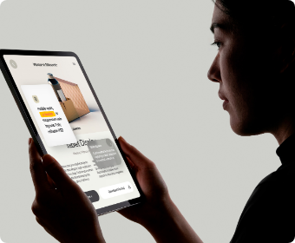

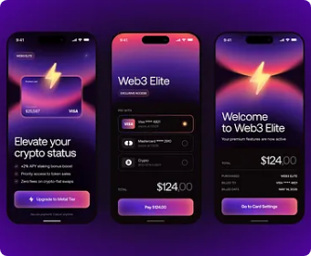
Functional Live Prototype Interface
Medical Profile Setup
Intelligent Menu Screening
Multilingual Alert Cards

Slide 7






Societal Value & Strategic Impact
Saves Vital Lives
Empowers Users
Supports Restaurants
Drastically curtails severe food allergy incidents, eliminating common human error vectors in food preparation.
Restores dining independence, confidence, and safety profiles for domestic users and international travelers alike.
Mitigates liability overhead, providing kitchens clear, actionable cross-contamination avoidance paths.

Slide 8
Future Horizons: Scale Strategy
Phase 2: Networks
Phase 4: Expansion
Verified emergency community medical volunteer grid.
Direct institutional B2B partnerships with schools & airlines.
Phase 1: Integrations
Phase 3: Resiliency
Deep Restaurant POS API & menu database loops.
Real-time active alert pipelines via satellite backup.

Slide 9
AllerSafe doesn't just inform users—it protects them in a world that isn't labeled for them.
"
"
— Gravity Coders

Slide 10
Thank You
Open for Q&A
Team Gravity Coders | Hackathon Pitch

Slide 11




Image Sources
https://cdn.babyseo.ai/images/foodshot.ai/restaurant-menu-board-design/restaurant-menu-board-design-hero.webp
Source: foodshot.ai
https://images.pixeden.com/images/minimalist-tablet-display-mockup-woman-in-silhouette_full_preview_retina.jpg
Source: www.pixeden.com
https://www.lightxeditor.com/blog/wp-content/uploads/2026/07/ChatGPT-Image-Jul-2-2026-04_04_14-PM.webp
Source: www.lightxeditor.com
https://cdn.dribbble.com/userupload/47870826/file/still-cd932cfc2f89c84585d9bf9b5f39b8e1.png?format=webp&resize=400x300&vertical=center
Source: dribbble.com

